Slide 2
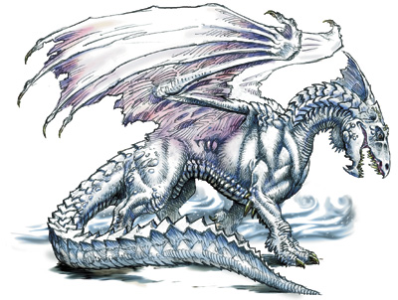
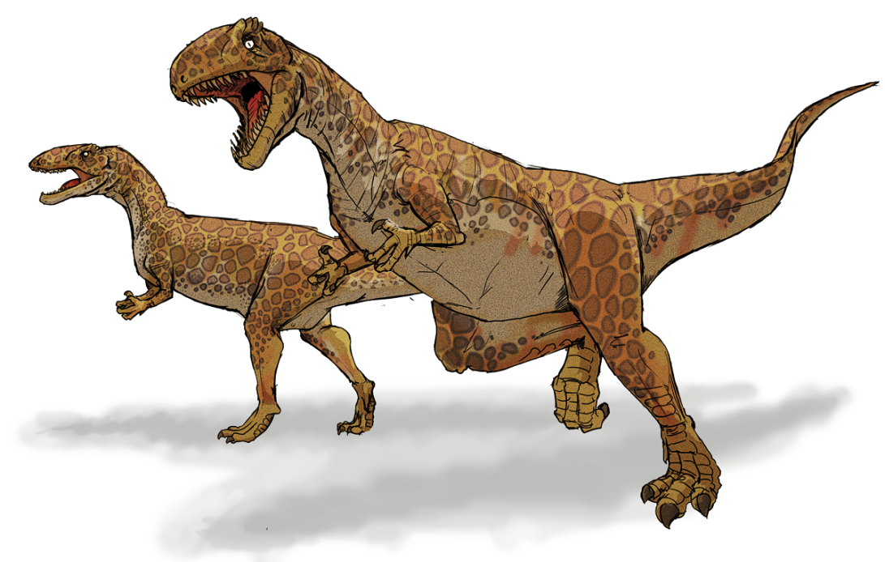
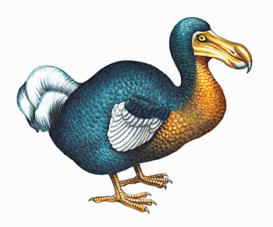
1. A DODO WAS A
BIRD
DRAGON
DINOSAUR

Slide 3
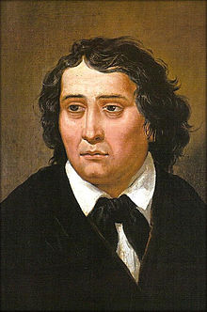
2. FRANCE PREŠEREN WAS A
FAMOUS ACTOR
A POET
A SINGER

Slide 4
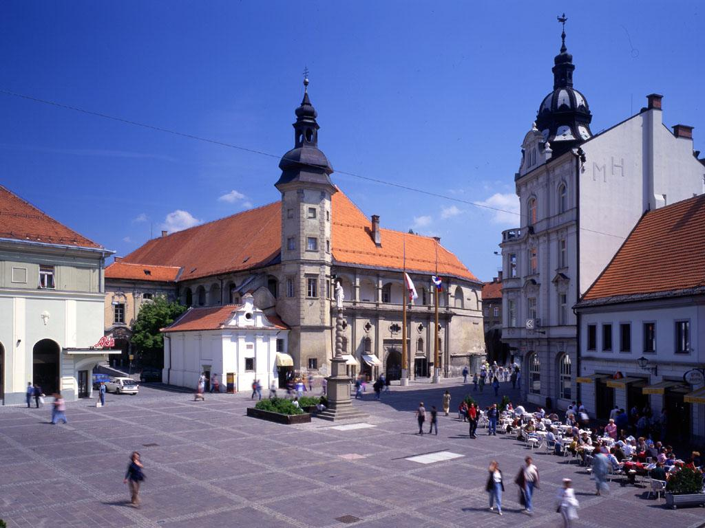
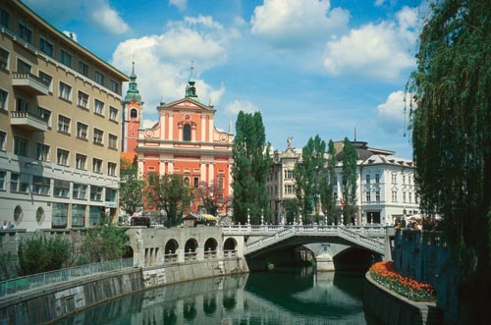
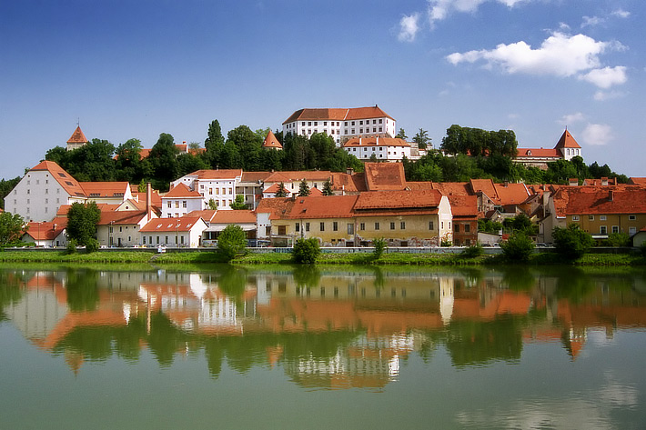
3. EMONA WAS THE ROMAN NAME OF
LJUBLJANA
MARIBOR
PTUJ

Slide 5
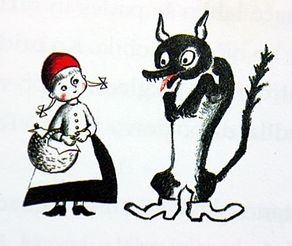
4. _________ WASN‘T IN LITTLE RED RIDING HOOD.
WOLF
HUNTSMAN
FIREMAN

Slide 6
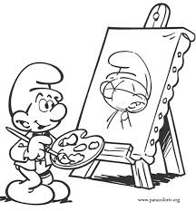
5. ________ WASN‘T A PAINTER.
IVANA KOBILICA
RIHARD JAKOPIČ
JOŽE PLEČNIK

Slide 7
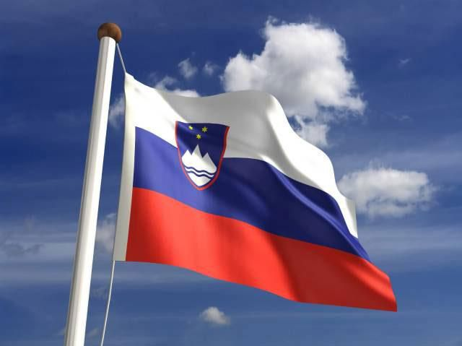
6. ________ WASN‘T THE PRESIDENT OF SLOVENIA
MILAN KUČAN
JANEZ JANŠA
JANEZ DRNOVŠEK

Slide 8
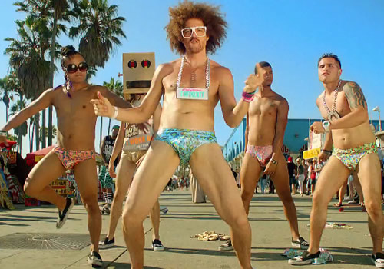
7. MICHEL TELO AND LMFAO WERE POPULAR
IN 2010
IN 2011
IN 2012

Slide 9
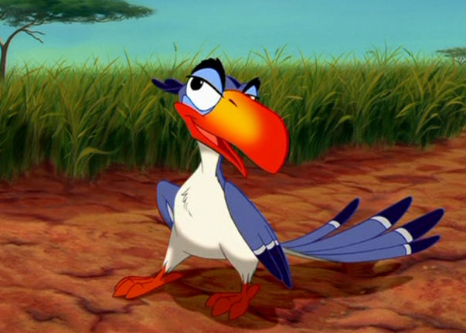
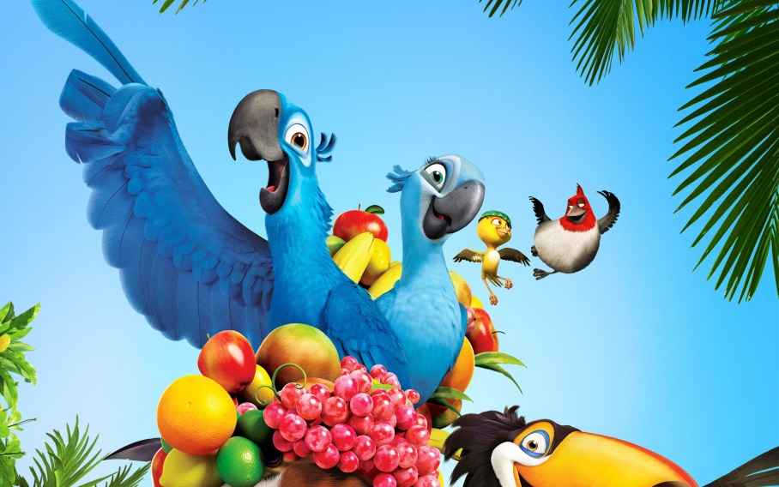
8. BLUE MACAWS BLU AND LINDA WERE IN ANIMATED FILM
LION KING
FINDING NEMO
RIO

Slide 10
9. PUPILS FROM OŠ POLJE WERE _________ LAST WEDNESDAY
ON HOLIDAYS
IN THE PARK
AT SCHOOL

Slide 11
10. PUPILS AND TEACHERS WEREN‘T AT SCHOOL
LAST WEEK
LAST YEAR
YESTERDAY

Slide 12
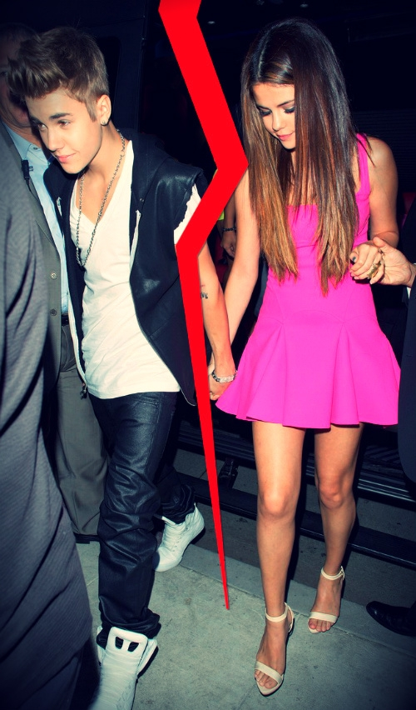
11. JUSTIN BIEBER AND SELENA GOMEZ WEREN‘T TOGETHER IN
AUGUST 2011
NOVEMBER 2012
DECEMBER 2012

Slide 13
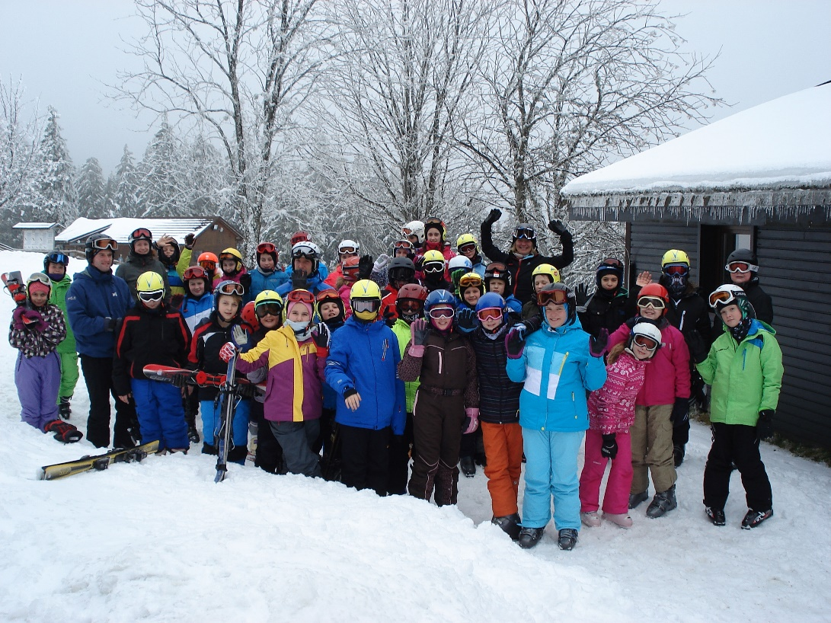
12. WE (7.A, 7.B AND 7.C) WEREN‘T ________ TOGETHER
IN PORTOROŽ
ON ROGLA
IN BIT FITNESS
CENTRE

