Slide 1
Key to exercises in lesson 3
Rešitve nalog iz 3. učne ure
(učbenik, str. 46; delovni zvezek, str. 38 in 39)

Slide 2
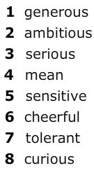
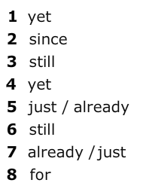
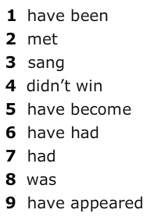
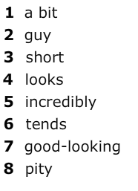
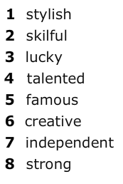
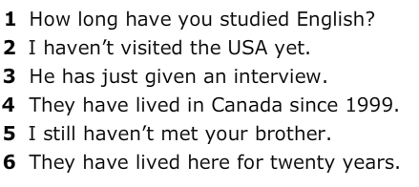
Student‘s Book p. 46
Exercise 1
Exercise 3
Exercise 5
Exercise 6
Exercise 2
Exercise 4

Slide 3
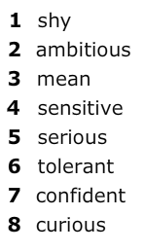
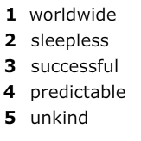
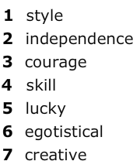
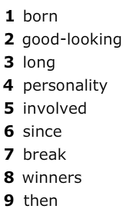
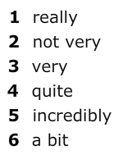
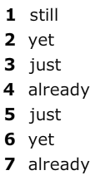
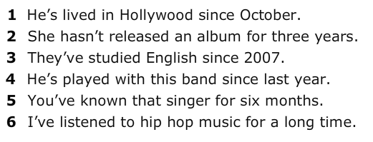
Workbook pp. 38 and 39
Exercise 1
Exercise 3
Exercise 5
Exercise 7
Exercise 8
Exercise 2
Exercise 4
Exercise 6

